Slide 1

PENDRAGON PLC
2022 INTERIM RESULTS
21st SEPTEMBER 2022

Slide 2
Agenda
1. Introduction
Bill Berman
2. H1 FY22 performance overview & divisional highlights
Bill Berman
3. Financial Review
Mark Willis
4. Group Strategy Update
Bill Berman
5. Summary & Outlook
Bill Berman
2

Slide 3
H1 FY22 performance overview
3

Slide 4
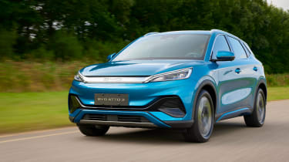
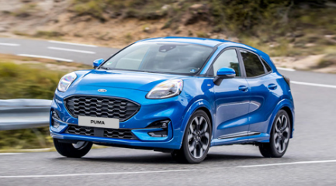
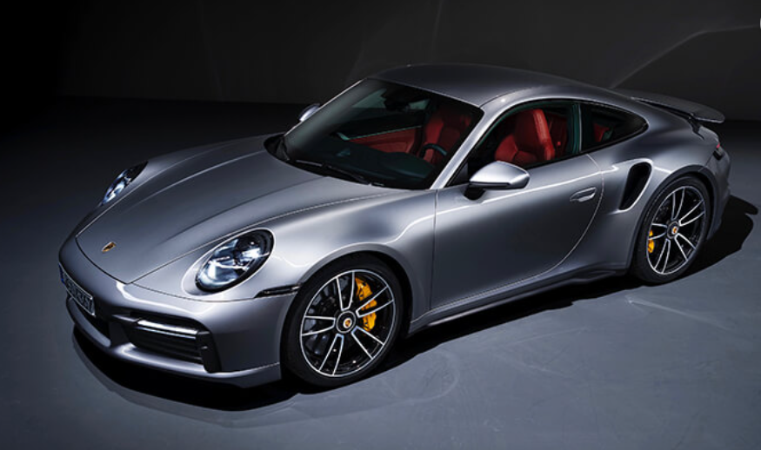
H1 FY22 Performance Overview
Operating
Highlights
Strong progress with strategy; with Pinewood powering delivery
Brand re-launch of Carstore.com, new used car omni-channel marketing campaign launched in May, driving >60% increase in web traffic to CarStore.com
Advanced discussions with BYD to act as lead launch partner in the UK
Financial Performance
Underlying profit before tax £33.5m (H1 FY21: £35.1m)
Gross profit of £232.2m, up 12.4% on a like-for-like basis
Cost increases of £20.8m in line with previous guidance – largely due to increased marketing costs and reversal of government support
Net cash of £2.8m as at 30 June 2022 (FY21: net debt £49.7m)
Outlook
Performance in early H2 2022 has been in line with our expectations
Supply constraints in new and used cars expected to continue for at least the remainder of 2022. Strong new car order bank of over 22,000 orders
Challenging macro-economic background, but we expect to deliver Group underlying PBT in line with the Board’s expectations
4

Slide 5
Divisional operating highlights
5

Slide 6
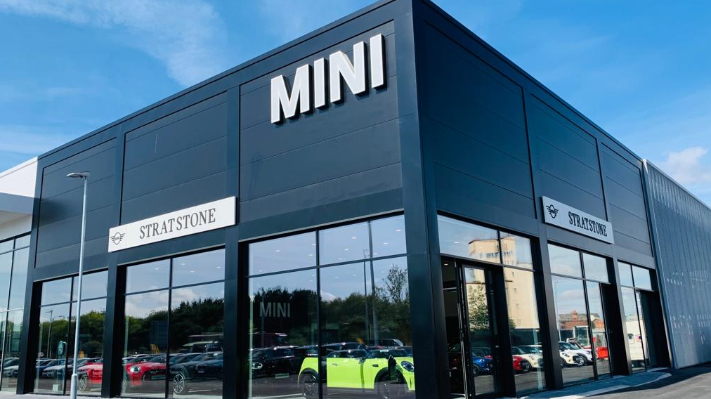

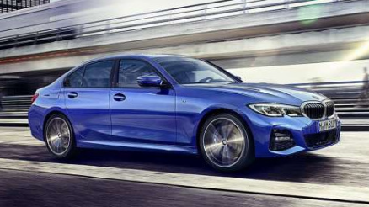
UK Motor
Previously reported Franchised UK Motor and Car Store divisions are now combined to reflect the new group-wide omni-channel approach to used car retailing
Investments in BMW sites in Hull & Derby, Mercedes Huddersfield, JLR Mayfair
New and used volumes decline, restricted supply impacting
Focus on maximising margin on both new and used vehicles, underpinned by strategy, driving higher gross profits per unit (GPU)
Aftersales revenue up by 3.9%, Gross margin up 1.8% to 51.3%
Total operating costs up £24.2m (16.2%)
Revenue:
+4.3% LFL
(+3.6% total reported)
Underlying Operating Profit:
£37.2m, -1.8%
(H1 FY21: £37.9m)
Aftersales Gross Margin:
51.3%
(H1 FY21: 49.5%)
New GPU:
£2,576
(+£956 vs. H1 FY21)
Used GPU:
£1,676
(+£310 vs. H1 FY21)
6

Slide 7


Pinewood
Development of a large number of new applications for Pendragon which will then be released to the external market:
  Vyne open banking payments
  Sales+
  Acquisition, management & pricing platform
  Finance & insurance
Further international growth driven by systems installations in European markets, good pipeline in place
International users now represent 23% of external users
Strong partnerships with strategic OEMs
Revenue:
£12.4m, +2.5%
Underlying Operating Profit:
£5.5m, -17.9%
(H1 FY21: £6.7m)
International users:
3% increase
7

Slide 8

Leasing
High margin on disposals, historical residual values benefitting from increased used vehicle prices
Profit on disposal up 130% per unit to £4,524
Supply constraints impacting fleet size. Strong order bank, over 2,400 vehicles on order
Revenue:
£42.9m, -12.4%
Underlying Operating Profit:
£10.2m, +25.9%
(H1 FY21: £8.1m)
8

Slide 9
Financial review
9

Slide 10
Key metrics: H1 FY22
Gross profit
Gross margin %
Underlying operating costs
Underlying profit / (loss) before tax
Net cash / (debt)
Revenue
H1 FY22
(148 stores)
£1,845.5m
+1.6% vs. H1 FY21
(+3.9% LFL)
£232.2m
+9.9% vs. H1 FY21
(+12.4% LFL)
£(180.1)m
+13.1% vs. H1 FY21
£2.8m
-£52.5m vs. FY21
12.6%
£33.5m
H1 FY21
(150 stores)
£1,815.6m
£211.2m
11.6%
£(159.3)m²
£35.1m
£9.5m
H1 FY20
(175 stores)
£1,218.3m
£135.3m
11.1%
£(146.1)m¹
£(31.0)m
£(46.0)m
Underlying operating costs include ¹ £34.4m of rates relief & furlough in H1 FY20, ² £8.3m in H1 FY21
10

Slide 11
Financial summary: Income statement
Income Statement (£m)
 | H1 FY22 | H1 FY21 | % Change
Revenue | 1,845.5 | 1,815.6 | +1.6%
Gross Profit | 232.2 | 211.2 | +9.9%
Gross Margin % | 12.6% | 11.6% | +1.0%
Operating Costs | (180.1) | (159.3) | +13.1%
Operating Profit / (Loss) | 52.1 | 51.9 | +0.4%
Operating Margin % | 2.8% | 2.9% | -0.1%
Interest | (18.6) | (16.8) | +10.7%
Underlying Profit Before Tax | 33.5 | 35.1 | -4.6%
Non-underlying Items | (0.6) | (4.3) | -86.0%
Profit Before Tax | 32.9 | 30.8 | +6.8%
Underlying Earnings Per Share | 1.9p | 2.3p | -17.4%
Revenue increase of 1.6%
  Like for like revenue increase of 3.9%
Strong gross margins
  Gross margin % increase of 1.0% to 12.6%
  New GPU +59.1%, used GPU +22.7% and increase in aftersales margin
Total operating costs up £20.8m (13.1%) in line with previous guidance
  Increase of £7m in marketing costs to support the used car proposition
  Reversal of £8.3m of government support, primarily rates rebates, received in H1 FY21
  Higher levels of cost inflation, partially offset by ongoing focus on cost saving opportunities
  Utility hedging offering some protection to 2023
Higher interest charge driven by increases in stocking interest, bank interest and lease interest
Non-underlying charges of £0.6m (H1 FY21: £4.3m):
  Net gains on disposals of £7.2m
  Impairment charges of £4.8m
  Pension costs of £0.2m
  Termination and severance costs of £0.2m
  Loss on refinancing of £2.6m
  Underlying profit before tax of £33.5m
11

Slide 12
Financial summary: Cashflow
Summary Cashflow (£m)
 | H1 FY22 | H1 FY21
Underlying Operating Profit | 52.1 | 51.9
Depreciation and Amortisation | 17.0 | 18.4
Share Based Payments | 1.7 | 1.4
Non-underlying Items | (0.2) | (0.8)
Contribution into defined benefit pension scheme | (6.5) | (6.3)
Working Capital and Contract Hire vehicle movements | 24.2 | 59.8
Cash Generated from Operations | 88.3 | 124.4
Capital Expenditure | (19.1) | (16.5)
Fixed Asset Vehicles Net Movement | - | 3.0
Business and Property Disposals | 12.6 | 28.8
Net Capital (Expenditure) / Income | (6.5) | 15.3
Tax Paid | (0.5) | (1.6)
Interest Paid excluding lease interest | (9.6) | (8.4)
Lease Payments & Receipts | (16.9) | (19.0)
Non underlying finance cost | (2.6) | -
Other | (0.7) | (0.8)
Decrease in Net Debt | 52.5 | 109.9
Opening Net Debt | (49.7) | (100.4)
Closing Net Cash | 2.8 | 9.5
Net cash of £2.8m, improvement of £52.5m vs. FY21
£88.3m cash generated from operations with strong trading driving cash inflow
  Underlying operating profit of £52.1m up slightly on H1 FY21
  Working capital inflow of £24.2m driven largely by timing benefits which will unwind in H2.
Net Capital Outflow of £6.5m
      Total Capital Expenditure outflow of £19.1m with investments in BMW, Mercedes, Porsche and a new Car Store development in Warrington
      Business and property disposals of £12.6m principally driven by a disposal of a vacant property in St. Albans for £10.5m
Reduction of lease payments & receipts of £2.1m, with the impact of inflationary rent increases more than offset by a reduction in the number of leasehold properties as a result of lease exits
      Deal completed with our largest landlord, resulting in the return of 12 vacant properties in exchange for lease extensions at key locations
Non-underlying finance costs of £2.6m driven by costs associated with the 2022 refinancing exercise
12

Slide 13
Financial summary: Balance sheet
Balance Sheet (£m)
 | Jun-22 | Jun-21 | Dec-21
Property | 222.5 | 219.4 | 217.6
Plant & Equipment | 24.3 | 32.1 | 24.2
Goodwill | 144.6 | 150.3 | 150.3
Intangibles | 11.7 | 10.7 | 11.1
Right of Use Assets - property | 133.8 | 133.2 | 126.5
Contract hire vehicle assets | 127.1 | 138.1 | 131.2
Inventories | 529.9 | 477.6 | 512.8
Receivables | 134.8 | 138.2 | 118.9
Net Assets Held as for Sale | 7.6 | 8.6 | 10.4
Net Tax Balance | 16.0 | 31.2 | 26.6
Retirement Benefit Surplus | 4.2 | - | -
Cash and Cash Equivalents | 96.7 | 83.2 | 37.6
Total Assets | 1,453.2 | 1,422.6 | 1,367.2
Payables | (749.7) | (752.8) | (689.1)
Lease Liabilities | (224.1) | (228.7) | (222.1)
Contract Hire Vehicle Liabilities | (113.9) | (146.1) | (119.5)
Retirement Benefit Obligations | - | (34.9) | (23.6)
Interest bearing loans and borrowings | (93.9) | (73.7) | (87.3)
Total Liabilities | (1,081.6) | (1,236.2) | (1,141.6)
Shareholders Funds | 271.6 | 186.4 | 225.6
Increase of £46.0m in net assets from £225.6m at Dec-21 to £271.6m at Jun-22, up £85.2m vs. Jun-21
Increase in property
  Due to capital investments
  Partially offset by disposal of excess property together with depreciation
Inventory increased by £17.1m from 31 Dec 21 from £512.8m to £529.9m
  Increase in the level of new car inventory
  Partially offset by a reduction in used car inventory
  New car inventory remains significantly below historic levels as a result of the ongoing supply shortages
Increase in payables
  from higher vehicle creditors as a result of the increase in vehicle inventory
  Working capital timing benefit
Pension scheme deficit reduced from a £23.6m deficit at Dec-21 to a £4.2m asset at Jun-22.
  The improvement of £27.8m comprises of contributions of £6.5m, net interest expense of £0.2m and a net actuarial gain of £21.5m
13

Slide 14
Group Strategy update
14

Slide 15
Recap: Our vision
  “Transform automotive retail through digital innovation & operational excellence”
15

Slide 16












Recap: Our strategy
  Strategy
1. Unlock value
in UK Motor
2. Disrupt
used cars
3. Grow & diversify
Pinewood
Accelerate digital innovation | Re-brand | Digital product extension
Drive operational excellence & best practice | Differentiate value proposition | Deliver material existing order pipeline
Enhance new car representation | Build flexible acquisition & fulfilment capability | Geographic expansion
Now underpinned by a lean & efficient cost base
16

Slide 17






1. Unlock value in UK Motor
FY22
delivery / plans
  Omnichannel strength & advanced digital operating model
Unlock value
in UK Motor
Sales+
Acquisition, management & pricing platform
Finance & Insurance
✓
✓
✓
Accelerate digital innovation
Insurance product automation
Real-time offer modification
H2: Menu pricing for insurance products
Market-based pricing augmented with internal indicators
H2: Data iteration
H2: In-store part-exchange & Sell Your Car journeys
Variable APRs by finance balance
Dynamic lender comparison
H2 / Q1 2023: Rate for risk
Drive operational excellence & best practice
✓
✓
Enhance new car representation
Powered by
Powered by
Powered by
17

Slide 18





1. Unlock value in UK Motor
FY22
delivery / plans
  New processes & products to drive margin
Unlock value
in UK Motor
Reconditioning
Aftersales
Product revision
Accelerate digital innovation
✓
✓
✓
Revised stock allocation
Revised processes & process automation
H2: Cosmetic opportunities
Productivity improvements
Vehicle health check upside
Interest-free finance
Tailored & tiered guarantees driving record penetration
H2: Further revision to pricing model
H2: Electric vehicle ancillaries
Drive operational excellence & best practice
✓
✓
Enhance new car representation
✓
18

Slide 19


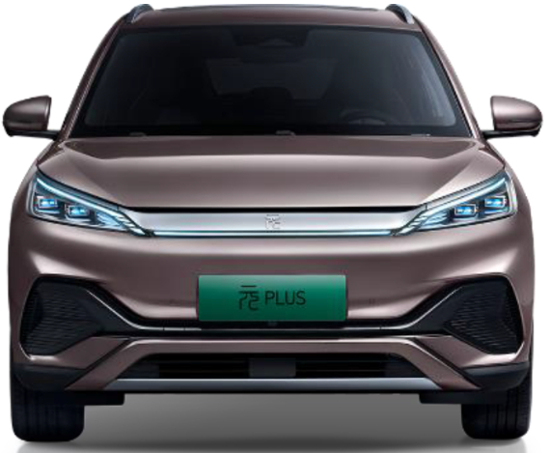
1. Unlock value in UK Motor
FY22
delivery / plans
  Advanced discussions: Lead UK launch partner for BYD
Unlock value
in UK Motor
✓
BYD
✓
Accelerate digital innovation
World’s largest new energy vehicle manufacturer
Q4: Lead UK launch partner
Q4: London & Birmingham as launch locations with potential for further co-locates
Q4: Launch with ‘ATTO 3’
Drive operational excellence & best practice
Enhance new car representation
19

Slide 20

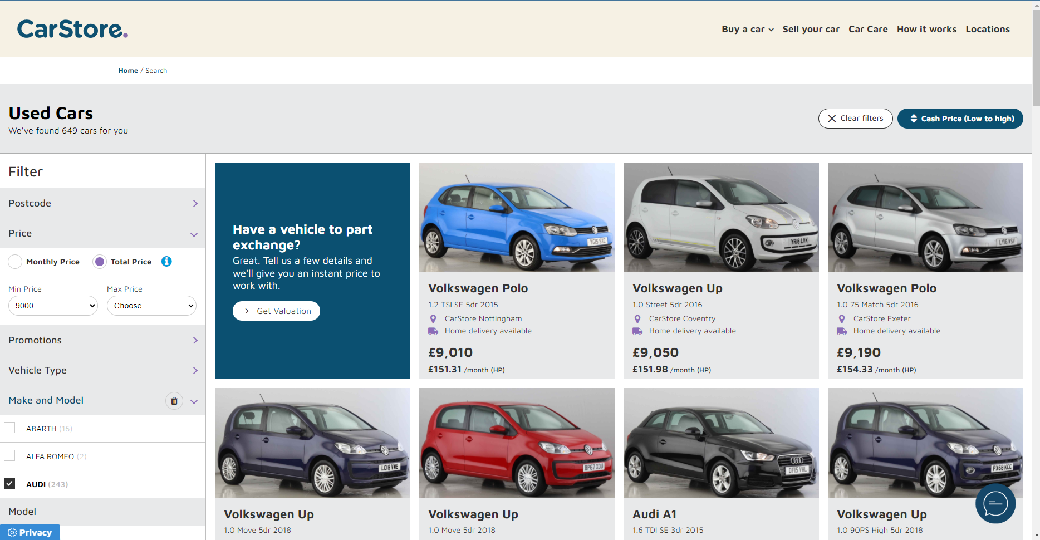


2. Disrupt used cars
FY22
delivery / plans
  Market leading omnichannel / hybrid customer proposition
Disrupt
used cars
Further proposition revision
✓
Re-brand
All Group stock to unlock marketplace
Greater scale than pureplay competitors
H2: Incremental acquisition via SellYourCar.com
Differentiate value proposition
✓
Build flexible acquisition & fulfilment capability
20

Slide 21
2. Disrupt used cars
  Comparison vs. end FY21: Maintained market leading omnichannel capability vs. digital disruptors
Digital
Fulfilment
Enquiry
Sale
Aftersales
Other
Brand | Trustpilot score | Live chat | Enquiry form | Reserve & book appointment | Cash purchase | Finance purchase | Part-exchange | Regulated products (e.g., tyre & alloy) | Non-regulated products | MOT & service booking | Sell Your Car | Click & collect | Home delivery
CarStore | 4.7 | ✓ | ✓ | ✓ | ✓ | ✓ | ✓ | ✓ | ✓ | ✓ | ✓ | ✓ | ✓ (£99)
Bravoauto | 3.0 | ✗ | ✓ | ✓ (reserve only) | ✓ | ✓ | ✓ | ✗ | ✗ | ✓ | ✓ | ✓ | ✓
Carshop | 4.4 | ✓ | ✓ | ✓ (reserve only) | ✓ | ✓ | ✓ | ✗ | ✗ | ✓ (request call-back only) | ✓ | ✓ | ✓
Carzam | Exited market
Cazoo (reduced geographic focus) | 4.7 | ✓ | ✗ | ✗ | ✓ | ✓ | ✓ | ✗ | ✓ | ✓ | ✓ | ✓ | ✓ (£149)
Cinch | 4.7 | ✓ (via WhatsApp) | ✗ | ✗ | ✓ | ✓ | ✓ | ✗ | ✓ | ✓ (via 3rd party; existing customers only) | ✓ (via sister website) | ✓ | ✓ (Free)
Digital disruptors
21

Slide 22



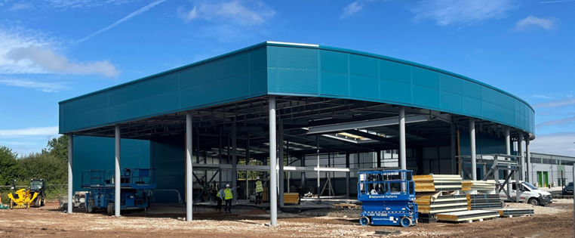
2. Disrupt used cars
FY22
delivery / plans
  Physical assets to support the omnichannel customer proposition
Disrupt
used cars
Stores
CarStore Direct
Re-brand
✓
✓
Evans Halshaw fulfilment
Rebrand of existing sites
Chesterfield concept store – April ‘22
H2: Warrington
Ten new locations live for SYC; Click & Collect
Low cost expansion
Unlocks whitespace opportunity
Differentiate value proposition
✓
✓
Build flexible acquisition & fulfilment capability
✓
✓
22

Slide 23
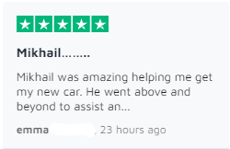


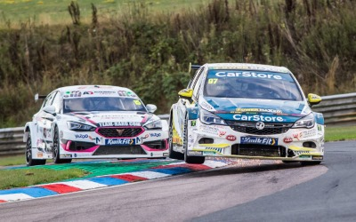

2. Disrupt used cars
FY22
delivery
  Successful launch of market-leading proposition
Disrupt
used cars
Proposition launch
Impact
Re-brand
✓
✓
Integrated omni-channel campaign
Prime-time TV advertising
British touring cars
Digital traffic up >60% YoY
New customer acquisition
H1 Reputation.com score 4.7 / 5.0, +0.3pts YoY
Differentiate value proposition
✓
✓
Build flexible acquisition & fulfilment capability
✓
✓
23

Slide 24


Slide 25

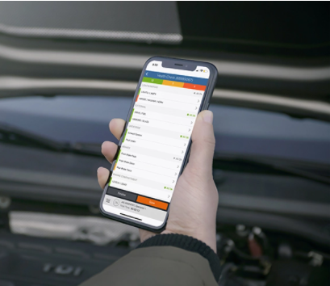

3. Grow & diversify Pinewood
FY22
delivery / plans
  Group omnichannel enabler & strong standalone pipeline
Grow & diversify Pinewood
Group omnichannel enabler
Growth & pipeline
Vyne open banking payments
Sales+
Acquisition, management & pricing platform
Finance & insurance
H2: Insurance menu pricing
H2: Aftersales
H2 / Q1: Rate for risk
✓
✓
Digital product extension
3% international user growth in H1
H2: c.1,000 new users projected
✓
Deliver material existing order pipeline
✓
✓
Geographic expansion
25

Slide 26
Summary & outlook
26

Slide 27
Summary & outlook
Excellent progress & FY profit in line with Board expectations
  We are pleased with the strong start to FY22 and remain confident we have the right strategy in place to deliver sustainable underlying PBT growth as the market recovers
  Trading through July and August has remained in line with our expectations
  Both new and used vehicle supply shortfalls are expected to continue for at least the remainder of the current financial year. Our new car order bank remains strong, with nearly 25,000 orders across our business units as at the end of June
  While the macro-economic backdrop remains challenging, with interest rate rises and other inflationary pressures, we continue to expect to deliver group underlying profit before tax in line with Board expectations for the current financial year
27

Slide 28
Appendix
28

Slide 29
Analyst modelling guidance
Guidance
Both new and used vehicle supply issues expected to continue for at least the remainder of 2022.
New and used margins remaining at higher than historical levels (pre-pandemic) offsetting the negative volume impact. New Car margins expected to remain stronger through H2
H2 FY22 costs and interest charges expected to higher than planned, offsetting increased new car margins
Capex expected to be c.£40m
Currently expect underlying PBT to be in line with Board expectations
29

Slide 30
Franchised UK Motor
30

Slide 31
Software - Pinewood
31

Slide 32
Leasing – Pendragon Vehicle Management
32

Slide 33
Franchised UK Motor - Aftersales
Reduction in 0-3 year car parc due to impact of reduced new markets in 2020, 2021 and 2022
The key 4-6 years car parc has fallen slightly to 6.8m cars
Growth in the 7-10 year car parc
33

Slide 34
Franchised UK Motor - New
UK New Car Registrations
Market Average /
Natural Level
The UK new car market was down 11.9% in H1 2022
Retail market represented 53.4% of the UK new market in H1 2022 (up from 48.7% of the market in 2021)
Forecast of 2.8% decrease in new car market in 2022 and a 17.9% increase in 2023
34

Slide 35
UK New Car Market
35

Slide 36
Financial Summary – 3 Year View
36

